Slide 1
Dynamic modeling, robust control and contact estimation of soft robotics
A Doctoral Dissertation Proposal
Zhi Qiao
Committee members:
Wenlong Zhang (advisor)
Hamidreza Marvi
Hyunglae Lee
Spring Berman
Thomas Sugar

Slide 2
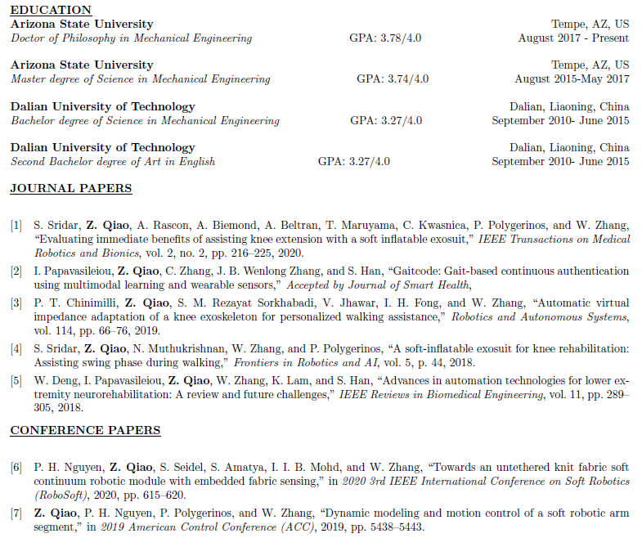
Background

Slide 3
Presentation Outline
Background and motivation
Overview of pneumatic actuated soft arm
Related work in model based dynamic control
Research gaps and contributions
Preliminary work
Data-driven model and robust controller for silicone actuator
Augmented-rigid arm model and sliding mode controller for fabric-pillow-based SISO system
Summary and Future work
Summary of the current work
Future work for augmented-rigid arm model and sliding mode controller for fabric-pillow-based SISO system
Future work for soft contact with environment using fabric-beam-based MIMO system
Timeline

Slide 4



Overview of soft arm design
Copy rights: (Left) China News Service;(Mid) Marvel Entertainment, LLC;(Right) Lucasfilm Ltd. LLC;
Having additional limbs has been a long dream for human beings
The additional limb can help both healthy and impaired users
Healthy user: holding multiple tools, extending reaching space
Impaired user: grasping objects, detecting objects
Compared with their rigid counterparts, soft arms shows advantages in:
Compliance
power-to-weight ratio

Slide 5
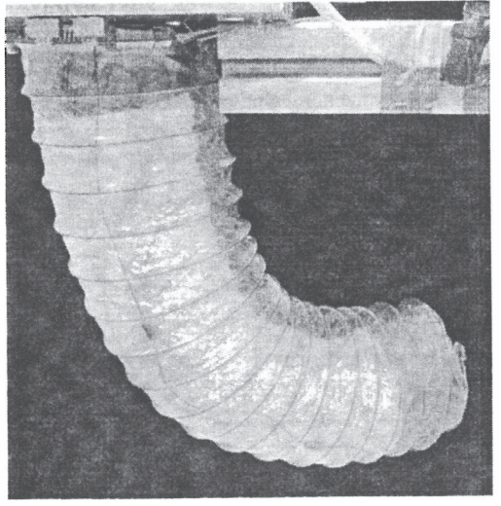
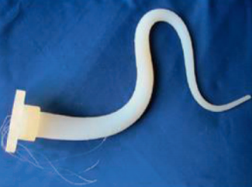
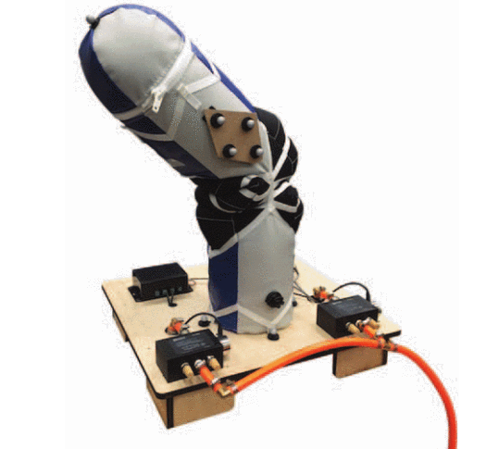
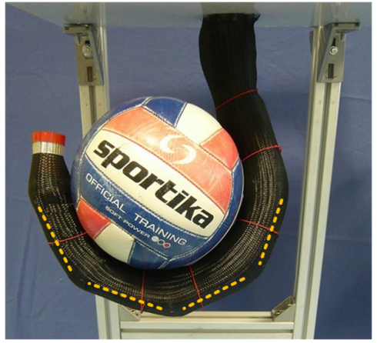
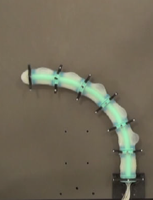
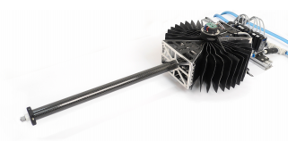
Overview of soft arm design
Prof. Ian Walker’s group (2004)
Prof. Ian Walker’s group (2009)
Prof. Marc D. Killpack’s group (2015)
Prof. Darwin G. Caldwell’s group (2013)
Prof. Daniela Rus’s group (2018)
Prof. Raffaello D’Andrea’s group (2019)
Notes:
Jones cable,

Slide 6
Related work in model-based dynamic control
Why soft system is hard to model?
Nonlinear material properties
Fabrication errors
Why not modeless control?
Training data-set is large and consumes tons of time
Performance is reduced when facing new and untrained environment
Why not high-dimensional finite element model-based control?
High-dimensional requires lots of computational resources
The performance doesn’t increase significantly when increase of the dimensions
Find a model that is low-dimensional but still can capture most of the dynamics of the system then design the controller on top of such model.

Slide 7
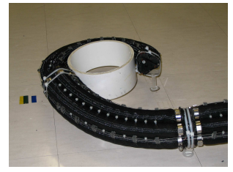
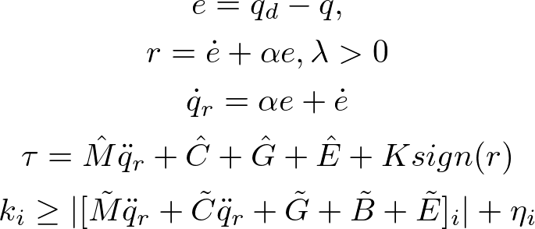
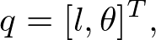
Related work in model-based dynamic control
Prof. Ian Walker’s group (2010)
Sliding model controller design
The error reaches the sliding surface in finite time and the state variables reach desired values exponentially fast.
System dynamic model where G, B, E represents the effects of gravitational energy, potential energy due to bending and extension
Limitations:
Assumes a backbone in the middle of the arm
System uncertainties due to damping effect and input signal is not included
No external disturbance estimation
Notes:
Three cables were used to map from task space to joint space

Slide 8
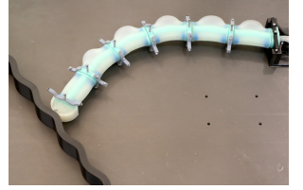
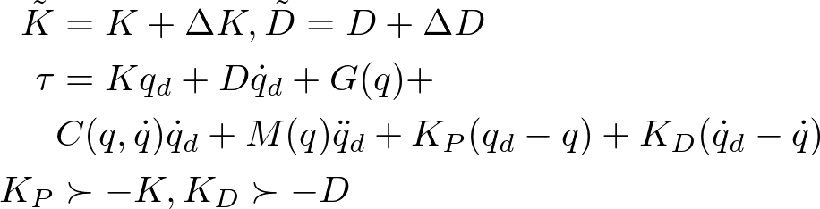
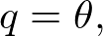
Related work in model-based dynamic control
Prof. Daniela Rus’s group (2020)
Curvature dynamic control with uncertainties
System dynamic model where G, K, D represents the effects of gravitational energy, material spring and damper effects
Limitations:
Framework only works for backbone located at the centerline
System uncertainties due to input signal is not included
No estimation for external disturbance

Slide 9
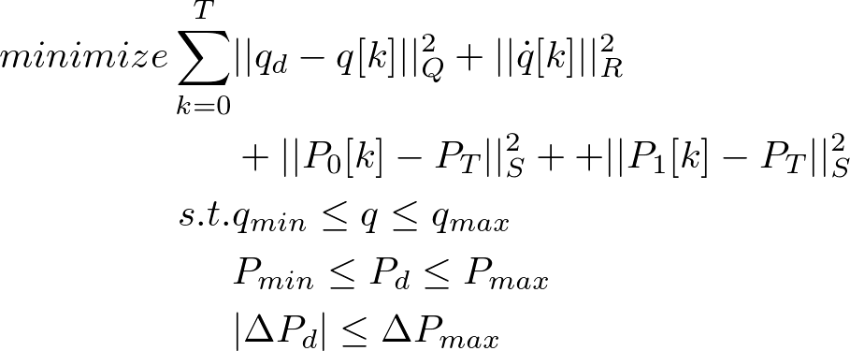
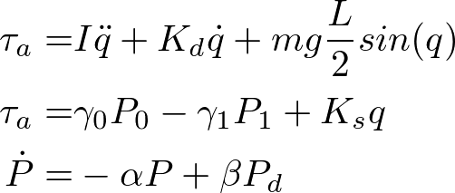
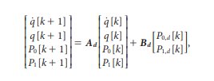
Related work in model-based dynamic control
Prof. Marc D. Killpack’s group (2015)
MPC controller design
System dynamic model (inverted pendulum)
Limitations:
The actuator needs to be specifically designed to fit the model requirements.
Gravitational term is ignored

Slide 10
Limitations and objectives
Research gaps
A backbone structure cannot cover the actuator without such feature
The input uncertainty was not considered in the controller design
External disturbance estimation is missing for CC assumption
“Dynamic modeling, robust control and contact estimation of soft robotics”
Contributions
Develop dynamic model for soft arm without backbone
Develop robust controller for lumped disturbance rejection
Develop disturbance estimator for contact event detection

Slide 11
Presentation Outline
Background and motivation
Overview of pneumatic actuated soft arm
Related work in model based dynamic control
Research gaps and contributions
Preliminary work
Data-driven model and robust controller for silicone actuator
Augmented-rigid arm model and sliding mode controller for fabric-pillow-based SISO system
Summary and Future work
Summary of the current work
Future work for augmented-rigid arm model and sliding mode controller for fabric-pillow-based SISO system
Future work for soft contact with environment using fabric-beam-based MIMO system
Future work for multi-segments whole body grasping

Slide 12
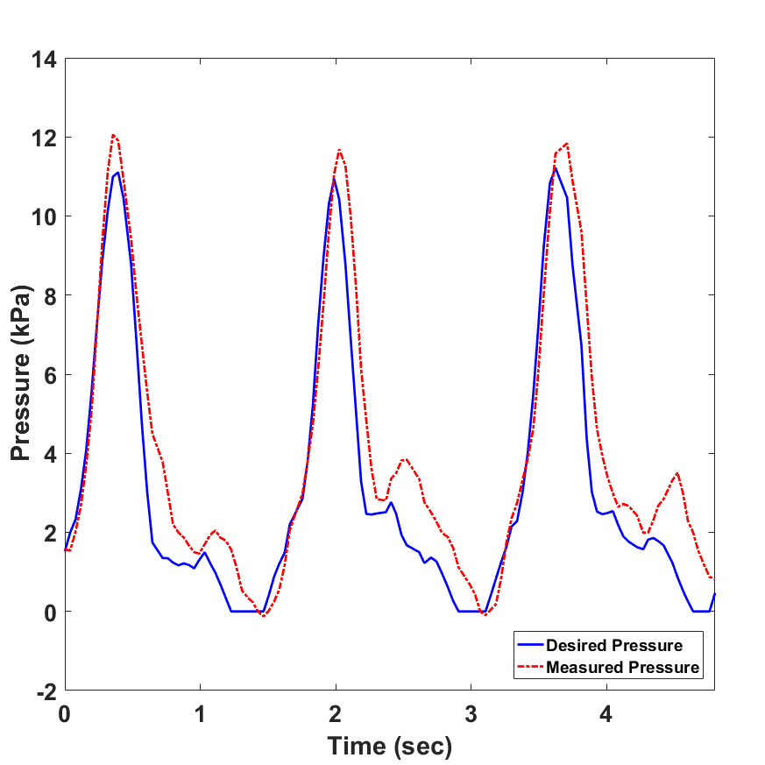
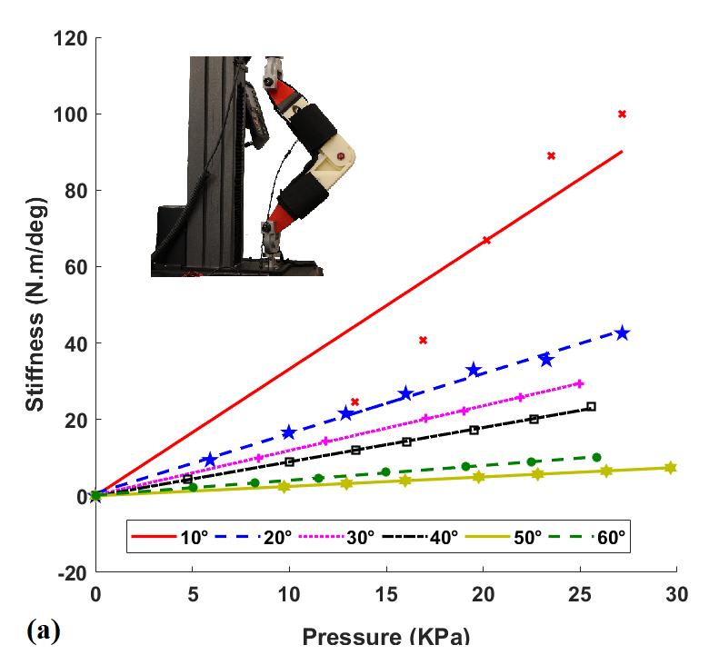
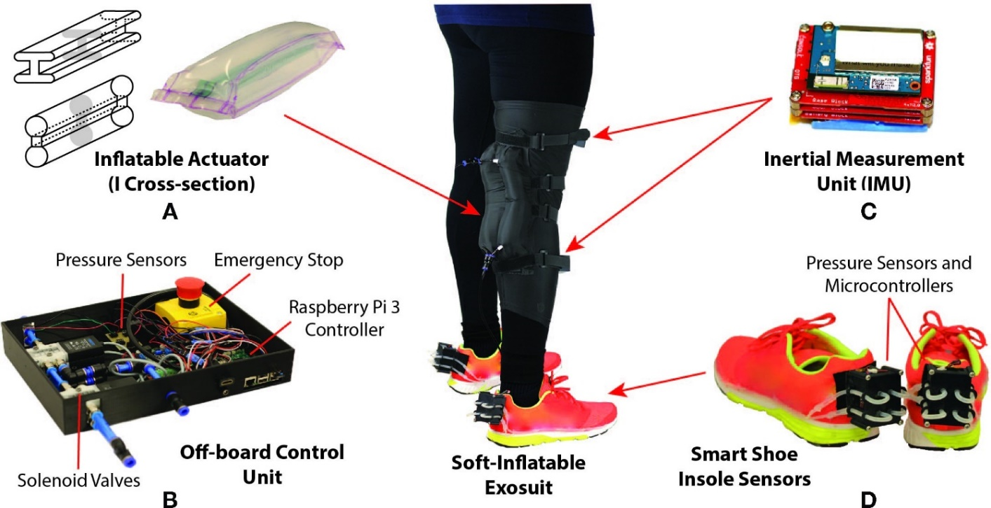
Insights from soft knee actuator
Experimental results. (Left) Pressure tracking (Right) Static characterization
Pressure dynamics needs to be considered for fast movement
Actuator stiffness can be modeled as a function of chamber pressure

Slide 13
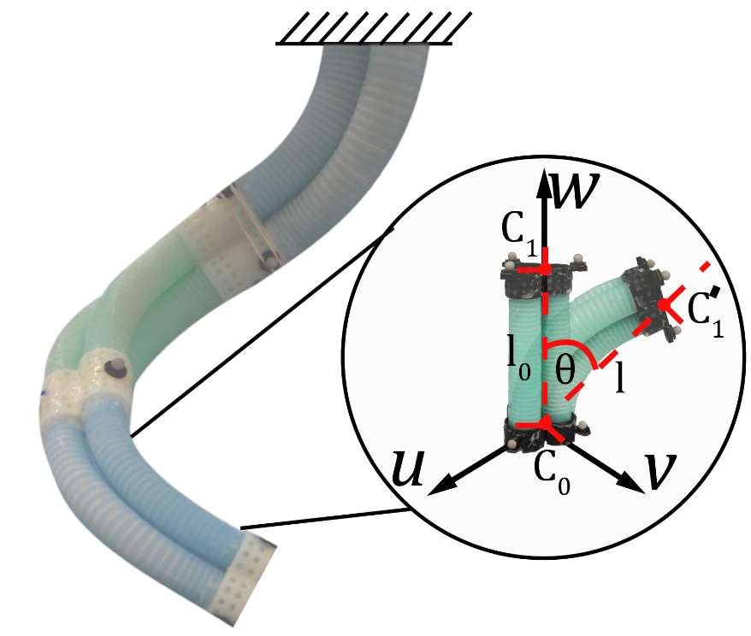
Contribution
Inspired from the soft knee actuator experiment, a linear parameter-varying (LPV) model for a silicone-based arm segment without backbone
H-infinity feedback controller combined with iterative learning control (ILC)
Experimental results

Slide 14
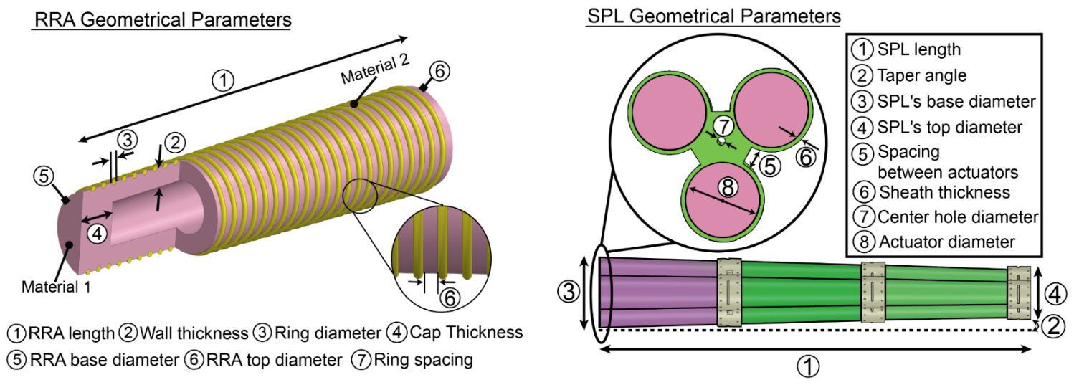

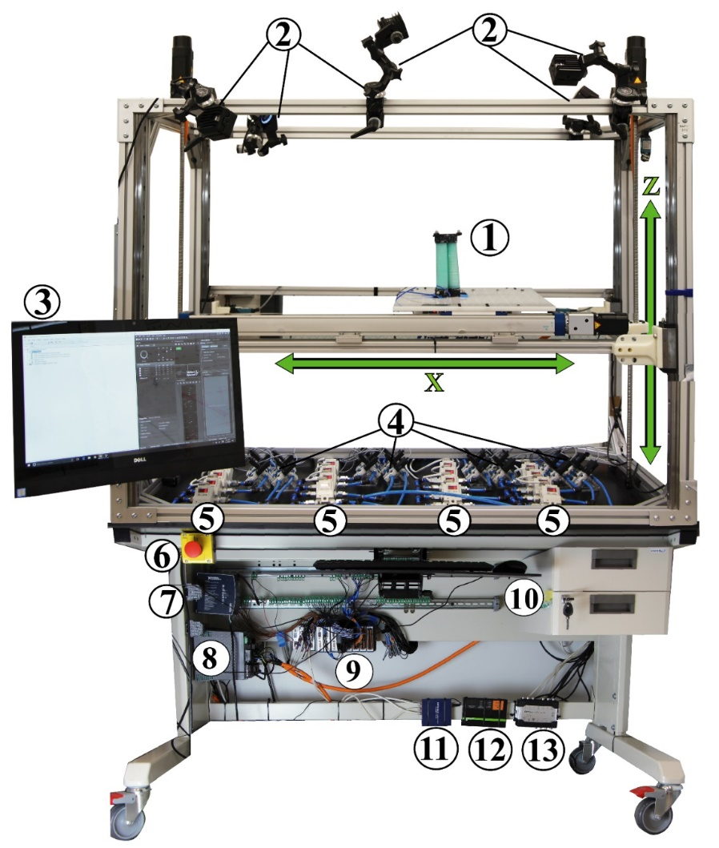

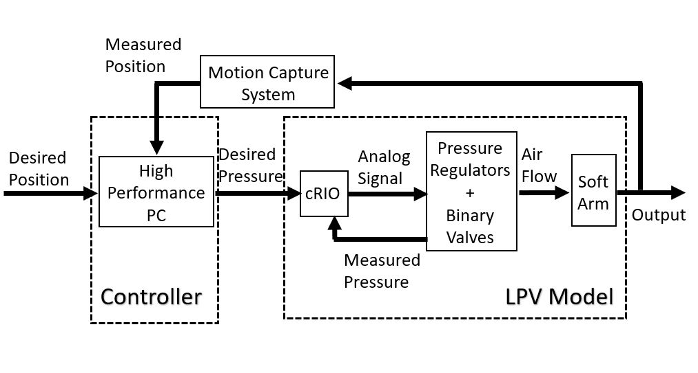


Hardware Setup
One Segment
Single chamber
Multi-segment Arm
Nguyen, Pham Huy, et al. (2019)

Slide 15
LPV Model
System parameters for bending and elongation motion are identified individually.
A mass-spring-damper model is identified
System is excited by a set of step inputs.
Control input and the elongation length is formed as an input-output-pair for MATLAB system identification toolbox.
Linear fit is applied to mass, spring and damper term with respect to operation point separately.

Slide 16
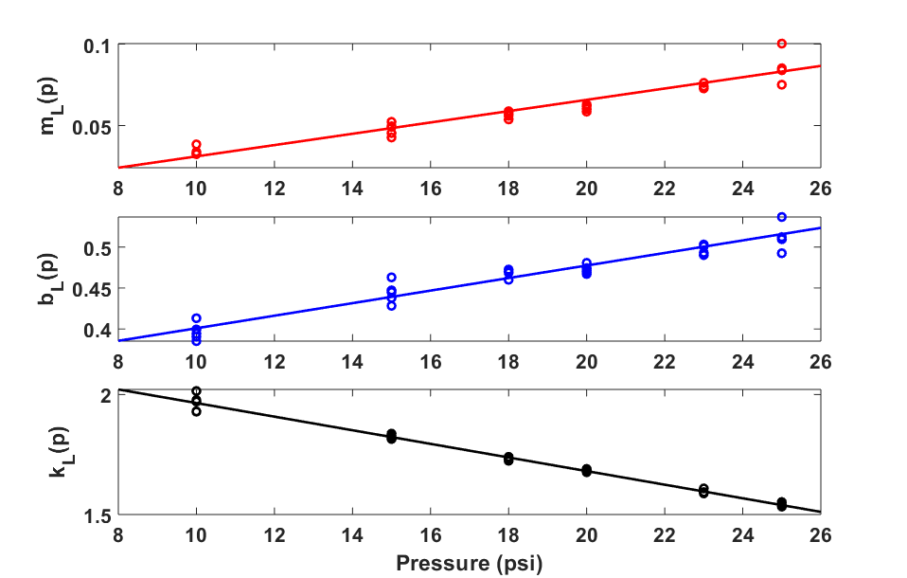
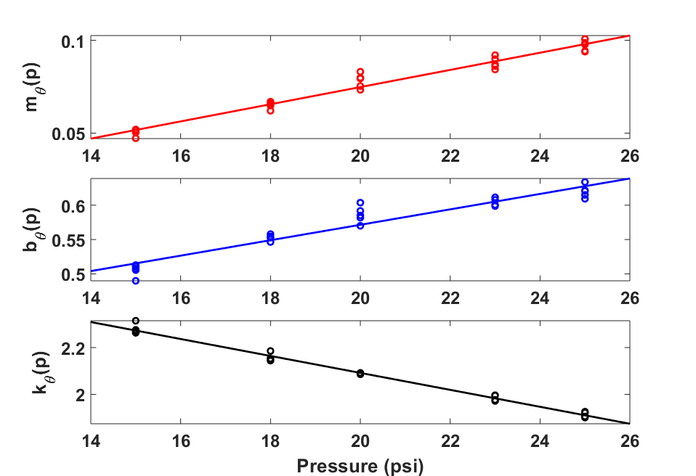
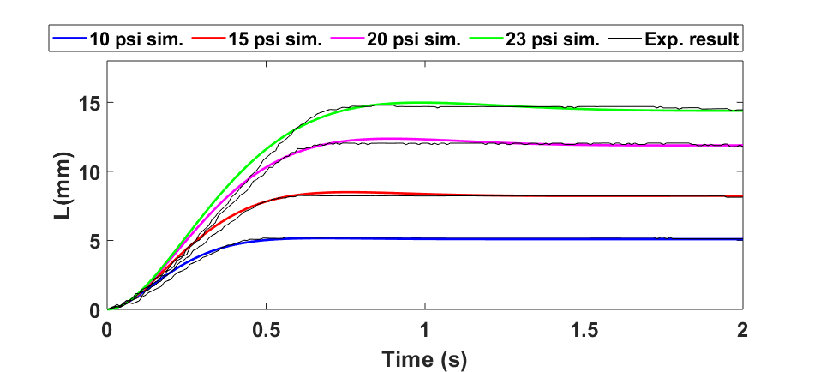
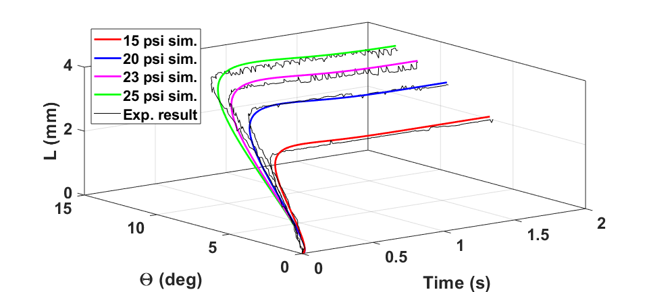
Parameter Identification and Model Validation
System parameter identification for (Left) elongation motion (Right) bending motion
Model validation for (Left) elongation motion (Right) bending motion

Slide 17
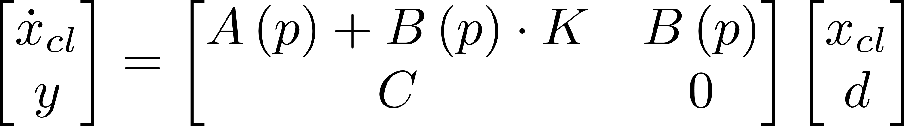
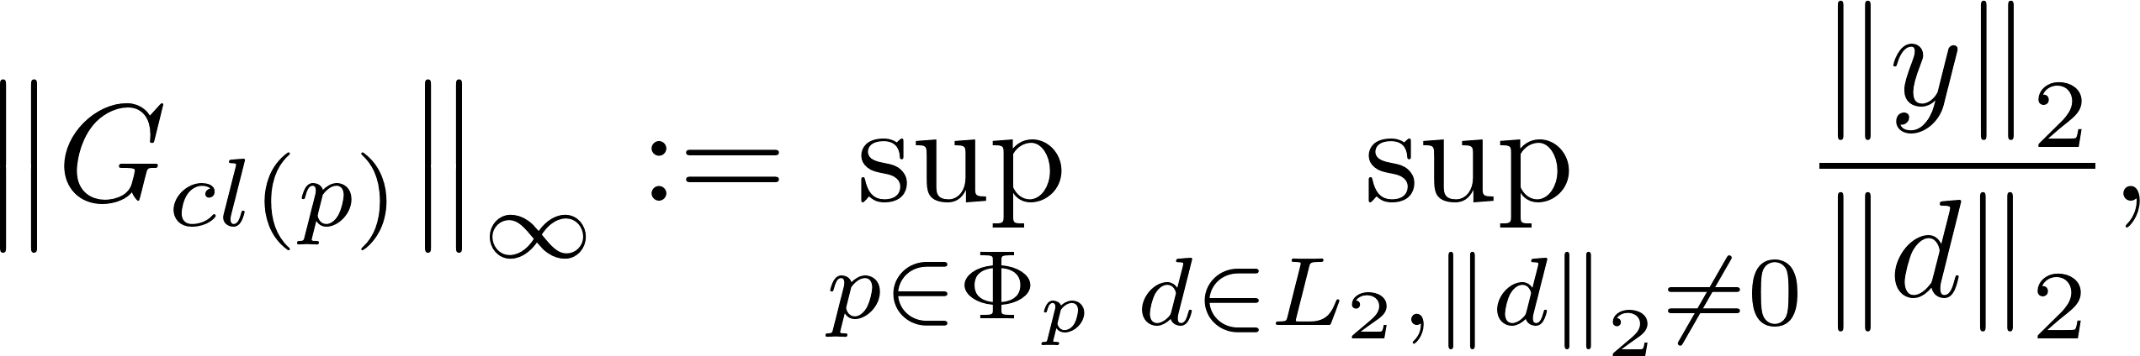
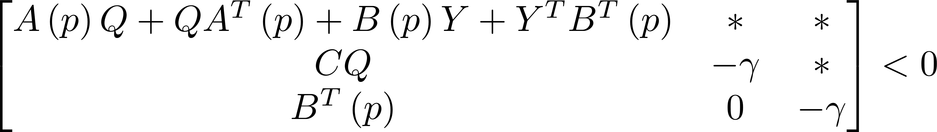
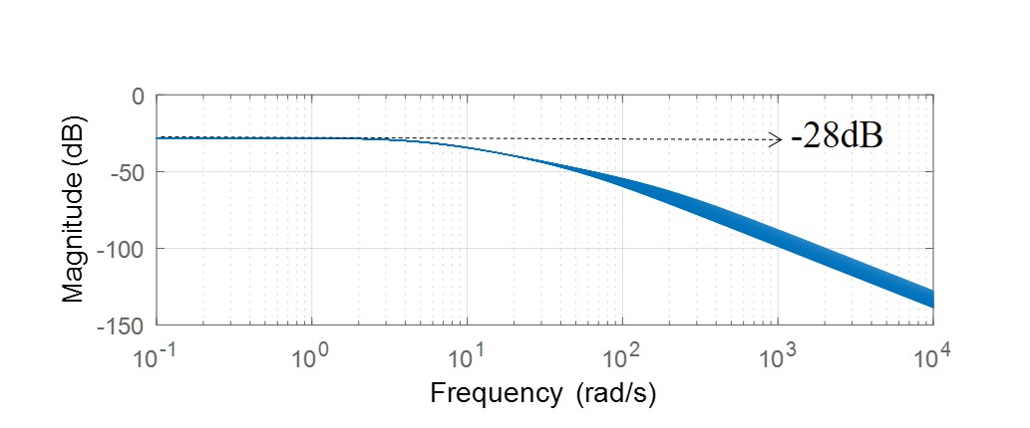
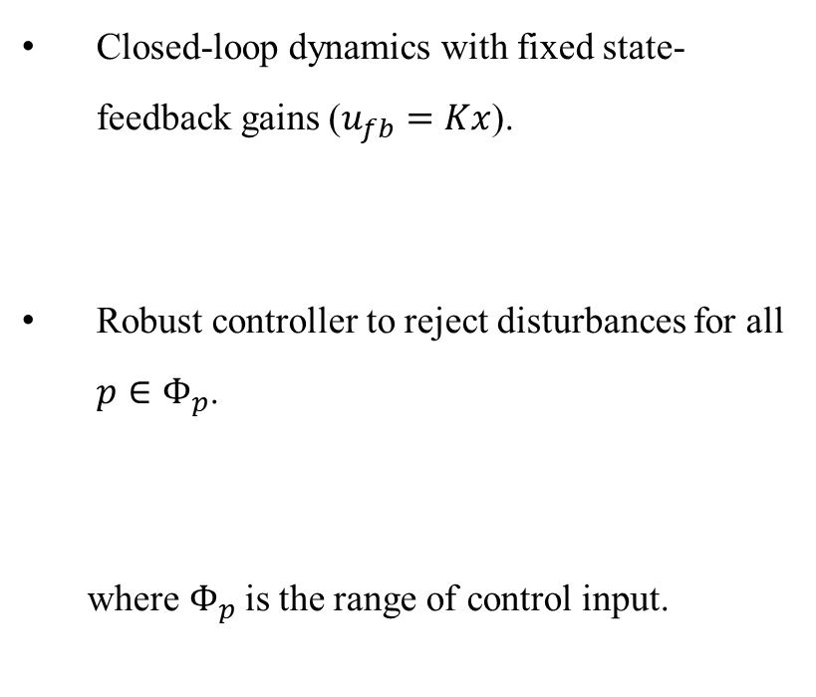
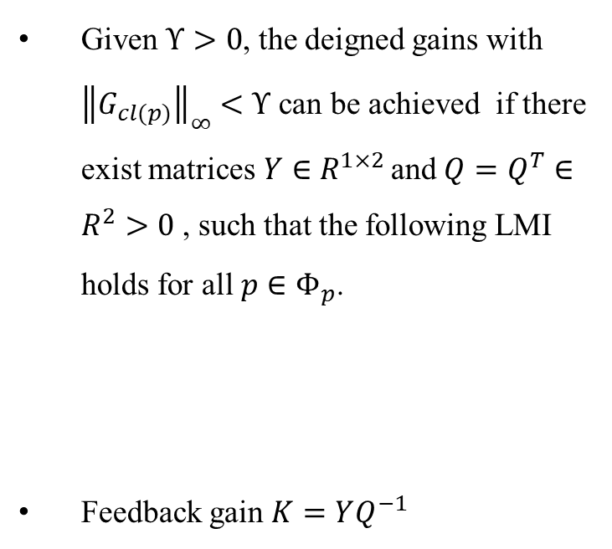
Feedback Controller Design
Closed-loop dynamics with fixed state-feedback gains ($u_{fb}=Kx$).
Robust controller to reject disturbances for all $p∈Φ_{p}$.
where${ Φ}_{p}$ is the range of control input.
Given $Υ>0$, the deigned gains with ${\left\|G_{cl(p)}\right\|}_{∞}<Υ$ can be achieved if there exist matrices$Y∈R^{1×2}$ and $Q=Q^{T}∈R^{2}>0$ , such that the following LMI holds for all $p∈Φ_{p}$.
Feedback gain $K=YQ^{−1}$

Slide 18
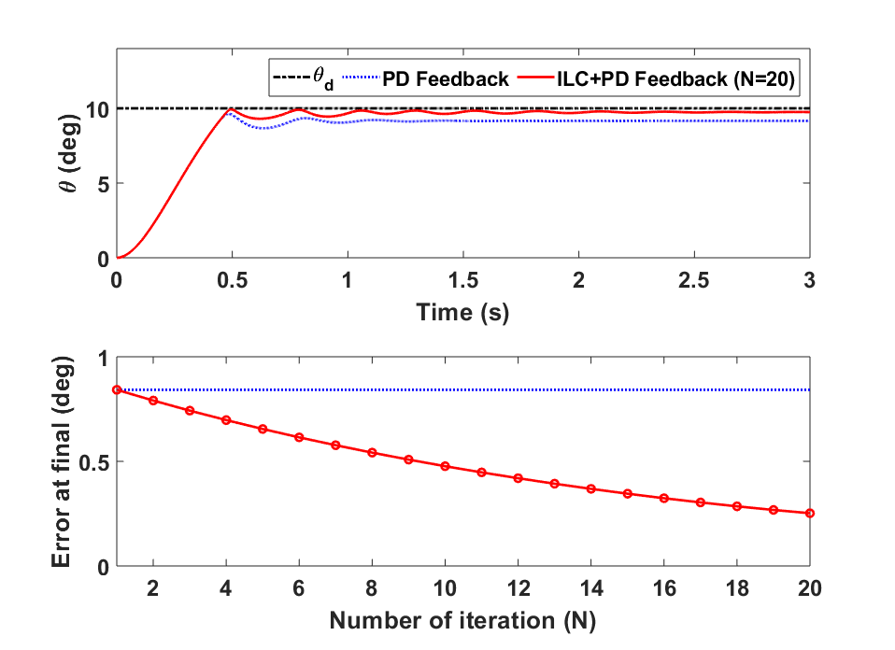
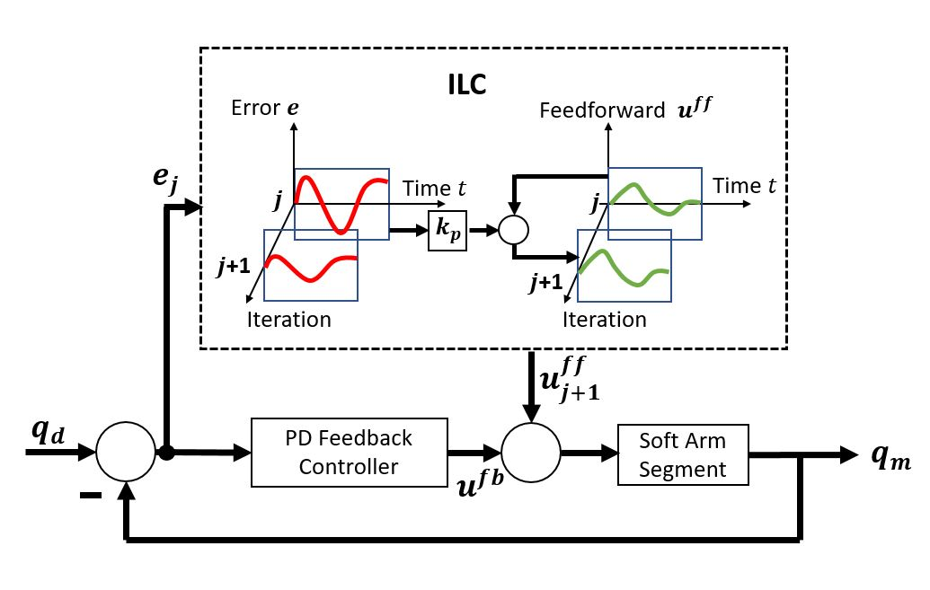
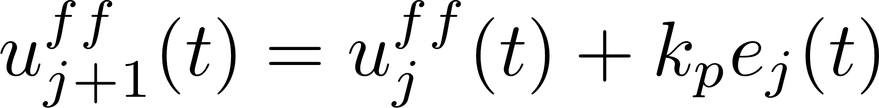
Combined Controller Design and Simulation
Feedback controller
Steady-state errors are observed in simulation (blue line)
Introducing an iterative learning control (ILC) term
Combine both feedforward and feedback term to achieve fast-tracking
Application allows repeated moves
Design of P-type ILC
(Top) Simulation results
(Bottom) PD feedback and ILC controller

Slide 19
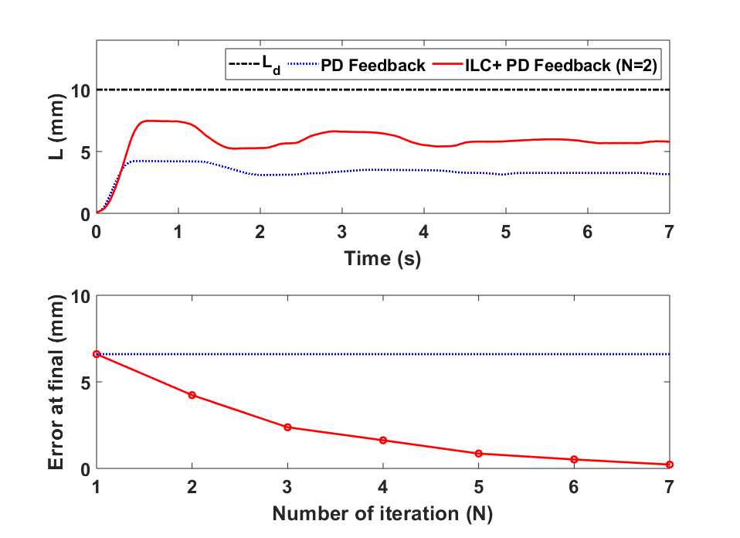
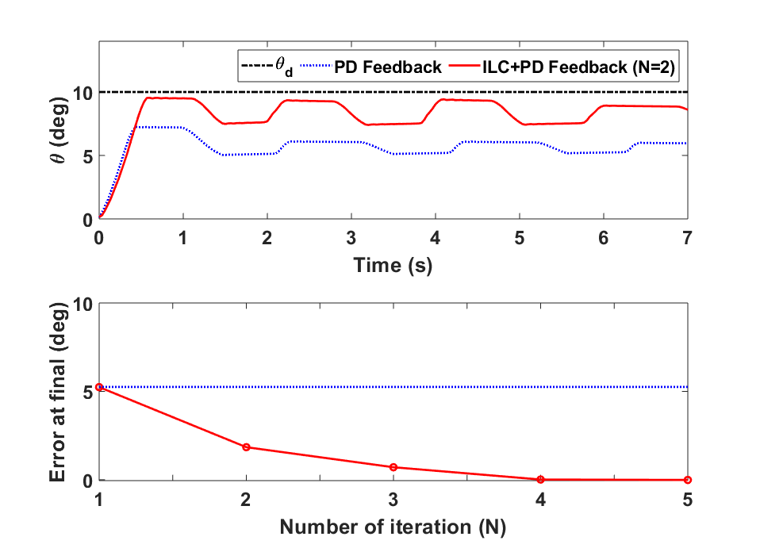
Experimental Results
Key Findings
The system shows large residual errors with PD-feedback controller Only (blue line).
With ILC term, the system performance increased with iteration number N.
Tracking errors are close to zero within 7 iterations.
Limitations of the experiment
Only small bending angle and elongation length scenario are tested.
Deflation dynamics is not included.
Simple mass-spring-damper framework cannot capture the full dynamics of the system.
Experimental results for (Top) elongation motion (Bottom) bending motion

Slide 20
Presentation Outline
Background and motivation
Overview of pneumatic actuated soft arm
Related work in model based dynamic control
Research gaps and contributions
Preliminary work
Data-driven model and robust controller for silicone actuator
Augmented-rigid arm model and sliding mode controller for fabric-pillow-based SISO system
Summary and Future work
Summary of the current work
Future work for augmented-rigid arm model and sliding mode controller for fabric-pillow-based SISO system
Future work for soft contact with environment using fabric-beam-based MIMO system
Timeline

Slide 21

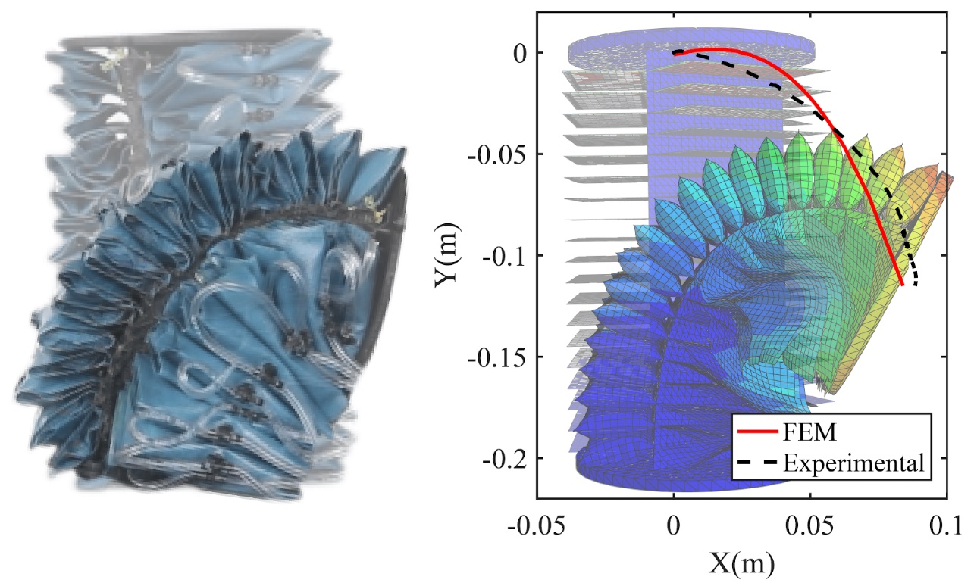
Limitations of Previous Work
Silicone material is heavy and stiff
Mass-spring-damper system accuracy is low
ILC cannot handle non-repetitive disturbance and noise
Lightweight fabric-pillow-based arm
Augmented-rigid arm model
Design sliding mode controller with disturbance observer for SISO system

Slide 22
Contribution
Develop augmented-rigid arm model for fabric-pillow-based actuator without backbone
Design a baseline SMC method for SISO system path tracking
Design a disturbance observer to reduce the input chattering and estimate lumped disturbance

Slide 23
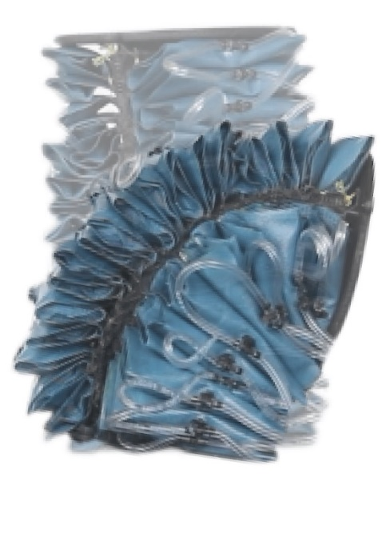
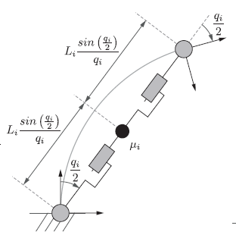
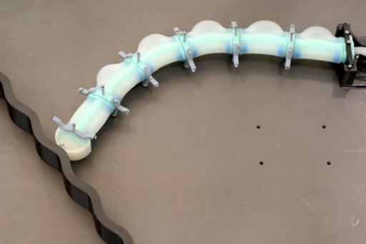
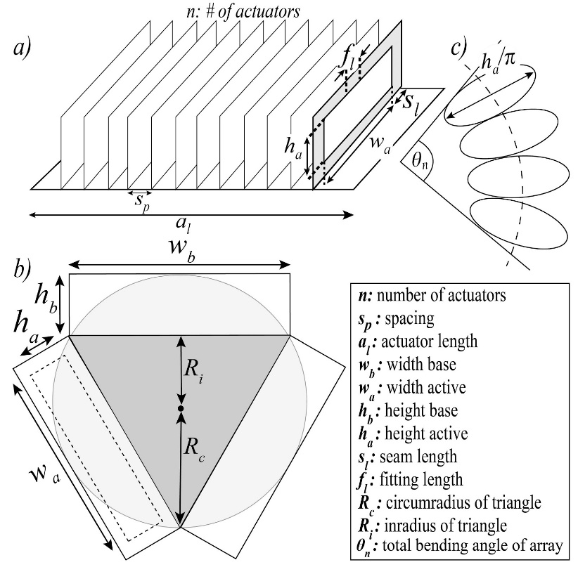
Augmented-rigid Arm Model
Prof. Daniela Rus’s group (2020)
MIT group:
Backbone in the center
Single chamber silicone actuator
Fabric-pillow-based arm:
Hollowed in the center but with inextensible layer
Serial connected pillow actuators

Slide 24

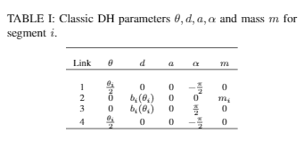
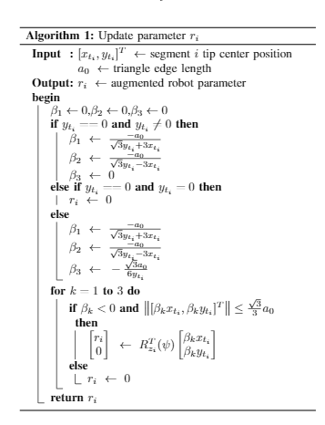
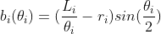
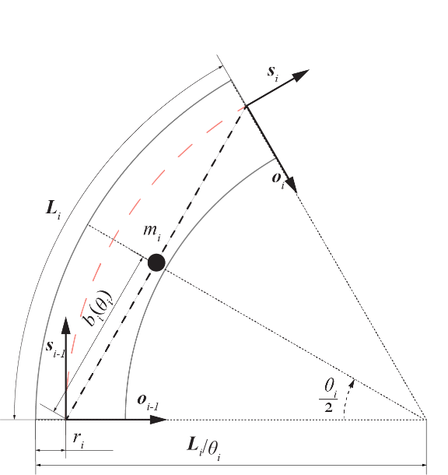
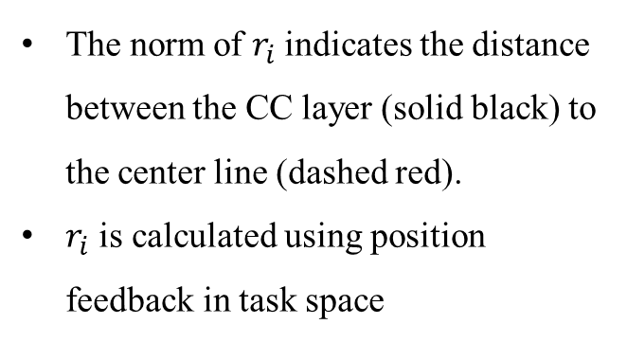

Kinematics with $r_{i}$
The norm of $r_{i}$indicates the distance between the CC layer (solid black) to the center line (dashed red).
$r_{i}$ is calculated using position feedback in task space

Slide 25
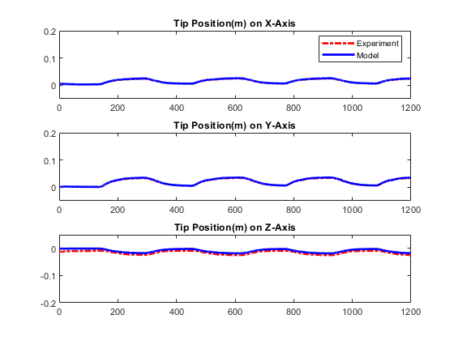
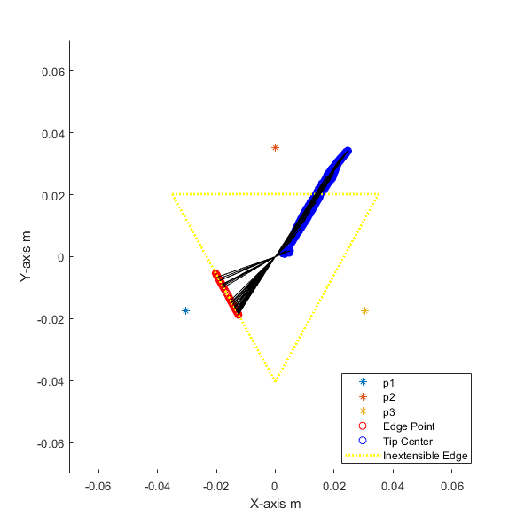


Forward Kinematic Results
Experiment setup
$θ,φ$ and $r_{i}$ is calculated from the motion capture position feedback
Center of the tip is estimated from $θ,φ$ and $r_{i}$ using the proposed model
Compare the estimation with actual measurement
Key findings
Introducing $r_{i}$ improves the kinematic model performance
The normalized estimation error is less than 1 percent
Experimental results. (Left) update rule
(Right) position errors in task space

Slide 26




Dynamic Model with Parameter Uncertainties
Full system dynamics
System Identification
Excitation Signal
Total trials: 30
Trial duration: 30 sec
System with bounded uncertainties
System ID results

Slide 27






Baseline SMC Design
State space representation
Control input
Stability proof
Sliding surface
Reaching law

Slide 28



Experimental Results
Experiment setup
Multi-steps signal: Randomly selected in [-10,-40] degrees
Sum-of-sines signal: frequency range [0.001,0.1] Hz
Key findings
Baseline SMC method can track refence signal in both cases
Input chattering needs to be reduced
(Left) Multi-Steps (Right) Sum of sine waves

Slide 29
Presentation Outline
Background and motivation
Overview of pneumatic actuated soft arm
Related work in model based dynamic control
Research gaps and contributions
Preliminary work
Data-driven model and robust controller for silicone actuator
Augmented-rigid arm model and sliding mode controller for fabric-pillow-based SISO system
Summary and Future work
Summary of the current work
Future work for augmented-rigid arm model and sliding mode controller for fabric-pillow-based SISO system
Future work for soft contact with environment using fabric-beam-based MIMO system
Future work for multi-segments whole body grasping

Slide 30
Summary
Developed a LPV model together with ILC for a silicone-based actuator for fast and robust movement
In progress of augmented-rigid arm model and sliding mode controller for fabric-pillow-based SISO system
Developed augmented-rigid arm model
Designed baseline sliding mode controller
Investigating the nonlinear disturbance observer for lumped disturbance estimation
Preparing to submit the work to IEEE Robotics and Automation Letters in Jan. 2021

Slide 31
Presentation Outline
Background and motivation
Overview of pneumatic actuated soft arm
Related work in model based dynamic control
Research gaps and contributions
Preliminary work
Data-driven model and robust controller for silicone actuator
Augmented-rigid arm model and sliding mode controller for fabric-pillow-based SISO system
Summary and Future work
Summary of the current work
Future work for augmented-rigid arm model and sliding mode controller for fabric-pillow-based SISO system
Future work for soft contact with environment using fabric-beam-based MIMO system
Timeline

Slide 32

Nonlinear Disturbance Observer
Assumptions
Lumped disturbance is bounded
The time derivative of the lumped disturbance is also bounded
When contacting with environment, the external disturbance is dominant
Goals
Reduce input chattering and estimate contact force
Find proper gain matrix for NDOB
Find proper candidate function to ensure the closed-loop system is stable

Slide 33

Simulation and Experiments
Simulations
Introduce constant external disturbances at time t and evaluate the convergence rate of the disturbance observer
Experiments
A 6-axis force/torque sensor will be place on the path of the actuator movement
Only tip will be in contact with the sensor
A comparison between the estimated external disturbance and sensor measurement will be conducted.
6-axis force/torque sensor
Schematic figure of the experiment

Slide 34
Presentation Outline
Background and motivation
Overview of pneumatic actuated soft arm
Related work in model based dynamic control
Research gaps and contributions
Preliminary work
Data-driven model and robust controller for silicone actuator
Augmented-rigid arm model and sliding mode controller for fabric-pillow-based SISO system
Summary and Future work
Summary of the current work
Future work for augmented-rigid arm model and sliding mode controller for fabric-pillow-based SISO system
Future work for soft contact with environment using fabric-beam-based MIMO system
Timeline

Slide 35

Limitations of Previous Work
Silicone material is heavy and stiff
Mass-spring-damper system is simple
ILC cannot handle non-repetitive disturbance and noise
System uncertainties is high
Actuation speed is slow
Performance drops significantly in low pressure
Fabric-beam-based Arm
Augmented-rigid Arm Model
Design SMCNDOB for MIMO system

Slide 36



Insights from fabric-beam-based Arm
System uncertainties is low due to reduced chamber
Performance is better in low pressure due to the new fabric
More complex motion can be achieved with same module
Stretch sensor with IMU allows more sensory feedback and out-of-lab application

Slide 37
Contribution
Develop augmented-rigid arm model for fabric-beam-based MIMO system in 3D space using local sensors
Design a baseline SMC method for MIMO system path tracking
Design NDOB for MIMO system and contact detection without force sensors.

Slide 38

Kinematics model using stretch sensor and IMU
System dynamic model where G, K, D represents the effects of gravitational energy, material spring and damper effects
A fusion algorithm of pressure sensor, stretch sensor and IMU will be designed to map the task space to the joint space
Unreliable

Slide 39

System ID for MIMO system
Experiment Setup
Excitation Signal
Total trials: 60
Trial duration: 60 sec
P_ctrl_1
Arm
P_ctrl_2
P_ctrl_3
MATLAB Grey-box system ID
Assume both stiffness and damping matrix are diagonal matrix.
Identify the parameters from each individual trial
Find 95 percent confidence intervals of the parameters as the system parameter uncertainty bound

Slide 40

SMCNDOB, Simulation and Experiments
SMCNDOB for MIMO system
Lumped disturbance is bounded
The time derivative of the lumped disturbance is also bounded
When contacting with environment, the external disturbance is dominant
Simulations
Introduce constant disturbance at different direction and different time to evaluate the convergence rate of the disturbance observer.
Experiments
Force/Torque sensor will be placed at different positions in the task space
Only the tip is in contact with the sensor
Results from the estimator and the sensor measurements will be compared.
6-axis force/torque sensor
Schematic figure of the experiment

Slide 41
Presentation Outline
Background and motivation
Overview of pneumatic actuated soft arm
Related work in model based dynamic control
Research gaps and contributions
Preliminary work
Data-driven model and robust controller for silicone actuator
Augmented-rigid arm model and sliding mode controller for fabric-pillow-based SISO system
Summary and Future work
Summary of the current work
Future work for augmented-rigid arm model and sliding mode controller for fabric-pillow-based SISO system
Future work for soft contact with environment using fabric-beam-based MIMO system
Timeline

Slide 42

Timeline
(Jan. 2021). Dynamic model and control of a fabric-based SISO system. Target: IEEE Robotics and Automation Letters
(Jul. 2021). Soft contact with environment using fabric-beam MIMO system. Target: Soft Robotics
(Dec. 2021). Multi-segments whole body grasping for assisting human motion Target: TBD

Slide 43
Refence
Jones, Bryan A., William McMahan, and Ian Walker. "Design and analysis of a novel pneumatic manipulator." IFAC Proceedings Volumes 37.14 (2004): 687-692.
McMahan, William, and Ian D. Walker. "Octopus-inspired grasp-synergies for continuum manipulators." 2008 IEEE International Conference on Robotics and Biomimetics. IEEE, 2009.
Best, Charles M et al. "Control of a pneumatically actuated, fully inflatable, fabric-based, humanoid robot." 2015 IEEE-RAS 15th International Conference on Humanoid Robots (Humanoids). IEEE, 2015.
Kang, Rongjie, et al. "Design, modeling and control of a pneumatically actuated manipulator inspired by biological continuum structures." Bioinspiration & biomimetics 8.3 (2013): 036008.
Della Santina, Cosimo, et al. "Dynamic control of soft robots interacting with the environment." 2018 IEEE International Conference on Soft Robotics (RoboSoft). IEEE, 2018.
Hofer, Matthias, Lukas Spannagl, and Raffaello D’Andrea. "Iterative learning control for fast and accurate position tracking with a soft robotic arm." Proc. IEEE/RSJ Int. Conf. Intell. Robots Syst.. 2019.
Kapadia, Apoorva D., et al. "A model-based sliding mode controller for extensible continuum robots." Proceedings of the 9th WSEAS international conference on Signal processing, robotics and automation. 2010.
Della Santina, Cosimo, et al. "Model-based dynamic feedback control of a planar soft robot: Trajectory tracking and interaction with the environment." The International Journal of Robotics Research 39.4 (2020): 490-513.
Nguyen, Pham Huy, et al. "Soft poly-limbs: Toward a new paradigm of mobile manipulation for daily living tasks." Soft robotics 6.1 (2019): 38-53.

Slide 44
Thank you!

